Slide 1
Discussion & Lecture Session Sound & Recording Check
Remote participants:
Log into Join.me
Announce yourself and provide your name on the phone and/or in the chat session
For Screen Sharing utilize your computer
For conference call audio utilize your computer speakers and microphone OR dial into the session with your mobile phone
Onsite participants:
Sit in a good spot near the “speaker phone” if possible
Optionally sign into Join.me… but make sure that your microphone and speakers are muted/off
Test recording by starting recording and then stop recording after a few seconds
Check recording sound when video is released by Join.me

Slide 2

Object-Oriented Programming Discussion, Lecture, & Lab Eric Pogue
Agenda for Wednesday, January 29th:
Friendly Conversation Topic
Announcements & Prework
Demos
Sprint 2 Retrospective
Recall FaceDraw
Sprint 3 Planning
Assignment
Lab
Discussion & Questions welcome at any time… please be present with no phones or email during our time together
Notes:
I hope everyone had a wonderful holiday and is coming back recharged and ready for a new semester.

Slide 3
Teamwork and Self-Improvement
Notes:
https://www.uline.jobs/JobSearchResults?culture=en&department=information%20technology&sort=Department-asc
Starting at 3pm in 106A

Slide 4
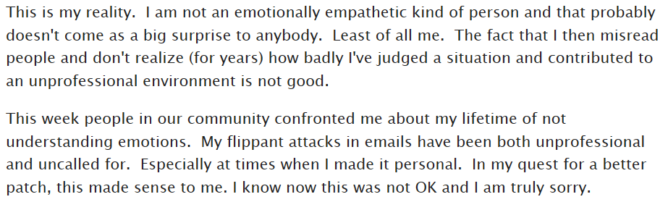
Who is the Author

Slide 5

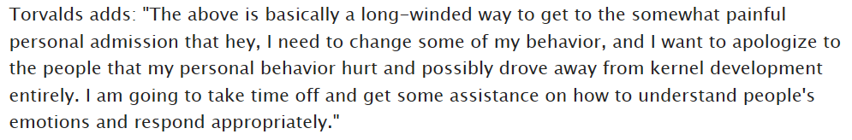
Answer

Slide 6
Suggested Reading: Dale Carnegie

Slide 7
Notes:
Optimism & Good-natured Humor

Slide 8
Announcements & Prework

Slide 9

Scrum Demo - Potentially Shippable Product
By Dr ian mitchell - Own work, CC BY-SA 4.0, Link
Notes:
Calendar, Activities List, and Assignments

Slide 10
Demos
Notes:
Grace period until Monday morning a 6am CT

Slide 11
Demos

Slide 12
Scrum Process – Sprint Retrospective
By Dr ian mitchell - Own work, CC BY-SA 4.0, Link
Notes:
Calendar, Activities List, and Assignments

Slide 13
Feedback?

Slide 14
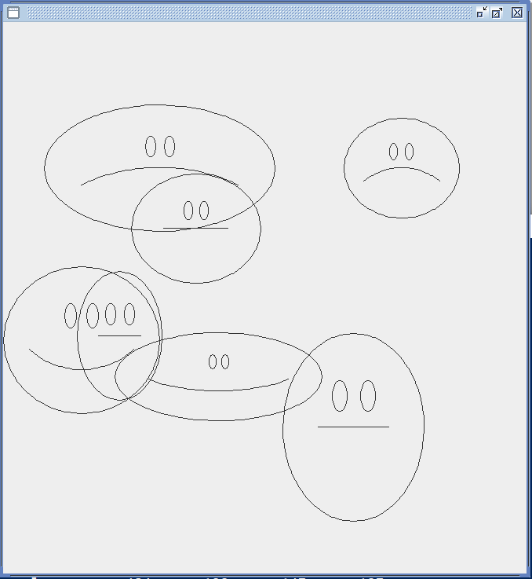
Recall FaceDraw
In the sprint 3 FaceDraw assignment, you will need to:
Create a graphical Java application
Draw 3 to 10 random faces on a window
Make each face a random width and height
Give each face a random emotion
Make it all visually appealing
And more
It will be challenging!

Slide 15
Scrum Process & Roles – Sprint Planning
By Dr ian mitchell - Own work, CC BY-SA 4.0, Link
Notes:
Calendar, Activities List, and Assignments

Slide 16
Assignment
ALL Assignments & Activity List Items are due this Sunday.
Prework assignments for next sprint will be communicated by Monday noon
Notes:
Grace period until Monday morning a 6am CT

Slide 17
Break & End of First Recording

Slide 18
Lab
As A Group:
Review FaceDrawLite (aka SadCyclopsFace)
Notes:
git clone https://github.com/EricJPogueCourses/OOP-ExampleCode.git

Slide 19
End of Session & Recordings

Slide 20
Backup Slides

Slide 21
Agile Manifesto
Agile Team Commitments:
Everyone is a team member and is responsible for getting the work done (we don’t need titles and positions)
We will actively and voluntarily play important roles on our team
The rules (rituals) that we do have… we WILL follow
We will create, demo, and release working software products
We will utilize practical processes, tools, documentation, and planning
When we make commitments, we will live up to those commitments… as a team (“No winners on a losing team, and no losers on a winning team”)
We will be responsive and continuously improve (Retrospectives)
We will be transparent with how WE work and share our information
Notes:
Agile Team Commitments
Everyone is a team member and is responsible for the work getting done
we don’t need no titles or positions
self-organizing
we will make our own commitments
transparency (let’s share the information)
flexible/organic teams, organic architecture (minimal appropriate documentation/standards)
no contracts (let’s talk it over)

Slide 22
Friendly Conversation Topic – Source Code Snippets in VS Code

Slide 23
One Space or Two Spaces After a Period?

Slide 24
Only One Space After a Period
Rule: Utilize one space after a period or similar punctuation [link]
Proportional based fonts like Helvetica and Times were designed to have the most visually appealing amount of space after the period.
Notes:
A possible exception would be non-proportional based fonts

Slide 25
Bonus MacOS Topic [link]
Notes:
And to stop zsh beeps:
unsetopt BEEP
setopt BEEP

Slide 26
Discussion: Shapes Step 1

Slide 27
Lab
As A Scrum Team:
Fix OvalDraw Together
Select two team members that will each share one OOP Principle or Design Characteristic
Programming Together – By Request
Programming Assignment 2 and Shapes Tutorials
Team report out by Scrum Master at 2:46
Team Report Out Guidelines
Scrum Master will stand up, give your name, your team name, and briefly answer the following questions:
What did you accomplish since the last meeting? And what will you be working on until the next meeting?
Is the team committed to completing assignments? All/Most/Some
What is getting in your way or keeping you from completing the assignments?

Slide 28
Lab
As A Scrum Team:
Review SOLID Design Principles
Prepare and share your OOP Principle or Design Characteristic including acronym
Review HelloWorld Plus upon request
Sprint 2 Assignments
Team report out by Scrum Master at 2:46
Team Report Out Guidelines
Scrum Master will stand up, give your name, your team name, and briefly answer the following questions:
What did you accomplish since the last meeting? And what will you be working on until the next meeting?
Is the team committed to completing assignments? All/Most/Some
What is getting in your way or keeping you from completing the assignments?

Slide 29

Agile Design Principles
Software design principles represent a set of guidelines that allow us to create high quality object-oriented designs. The design principles are attributed to Robert Martin who gathered them in the book "Agile Software Development: Principles, Patterns, and Practices".
According to Robert Martin there are 3 important characteristics of a bad design that should be avoided:
Rigidity – The system is hard to change, even to implement what seems like simple changes.
Fragility – The system tends to break in many places when a single change is made. And fixing the problems tend to lead to more creates more issues.
Immobility – The system is hard to reuse in another application because it cannot be disentangled from the current application.
Plus Viscosity, Needless Complexity, Needless Repetition, and Opacity.
Notes:
Our procedural (C) implementation of BMI would be a great example of Immobility… maybe a good example of all three of these.

